Slide 1

Preceptor training
Bsn, cnl, Advanced practice, DNP
Required module for uva clinical nursing faculty & preceptors | Updated February 2025

Slide 2
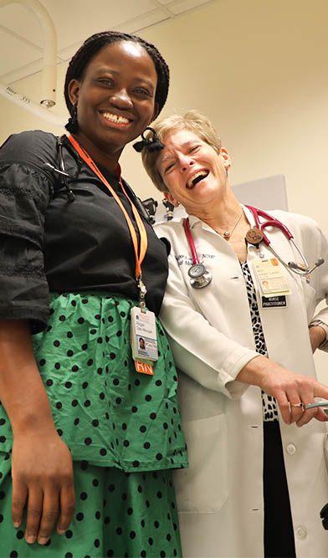
CONTENTS
Virginia Board of Nursing Regulations
Roles & Responsibilities for Course Faculty, Clinical Faculty, Students, & Preceptors
Professional Standards for Students
Getting Started and Phases of the Experience
Important Resources for Preceptors (Checklist)
Notes:
When adding pictures, be sure to add alt-tags to all presentation images.
Please note: Agenda items have been broken out into individual items in accordance with ADA digital accessibility best practices.

Slide 3
Preceptors:
This group of skilled, professional nurses serves as the on-site clinical teacher, mentor, and professional role model for students.
Linking classroom learning to the clinical setting
Enhancing the profession by helping create excellent new nurses.
Show & share knowledge, effective communication & collaboration skills, clinical judgement & problem-solving skills, compassion, and leadership.

Slide 4
Virginia Board of Nursing Regulations
18VAC90-27-110. Clinical practice of students.
In accordance with §54.1-3001 of the Code of Virginia, a nursing student, while enrolled in an approved nursing program, may perform tasks that would constitute the practice of nursing. The student shall be responsible and accountable for the safe performance of those direct client care tasks to which he has been assigned.
Faculty members or preceptors providing onsite supervision in the clinical care of clients shall be responsible and accountable for the assignment of clients and tasks based on their assessment and evaluation of the student's clinical knowledge and skills. Supervisors shall also monitor clinical performance and intervene if necessary for the safety and protection of the clients.
Clinical preceptors may be used to augment the faculty and enhance the clinical learning experience. Faculty shall be responsible for the designation of a preceptor for each student and shall communicate such assignment with the preceptor. A preceptor may not further delegate the duties of the preceptorship.
Preceptors shall provide to the nursing education program evidence of competence to supervise students' clinical experience for quality and safety in each specialty area where they supervise students. The clinical preceptor shall be licensed as a nurse at or above the level for which the student is preparing.
In utilizing preceptors to supervise students in the clinical setting, the ratio shall not exceed two students to one preceptor at any given time. During the period in which students are in the clinical setting with a preceptor, the faculty member shall be available for communication and consultation with the preceptor.

Slide 5
Per the Virginia Board of Nursing Regulations:
Preceptorships shall include:
Written objectives, methodology, and evaluation procedures for a specified period of time to include the dates of each experience;
An orientation program for faculty, preceptors, and students;
A skills checklist detailing the performance of skills for which the student has had faculty-supervised clinical and didactic preparation; and
The overall coordination by faculty who assume ultimate responsibility for implementation, periodic monitoring, and evaluation.

Slide 6
Course Professor Responsibilities Include:
Communicating course expectations & requirements to students, clinical faculty, and preceptors.
Overall responsibility for ensuring that students meet the course objectives.
Assigns final course grades.
Resource as needed for clinical faculty and preceptors in problem-solving student issues.
Notes:
This template is designed to automatically use the UVA brand colors as the chart theme, however, in order to maintain accessibility, be sure to add patterns to the lighter colors. Font colors and sizes should be adjusted as necessary, not dropping below 18 pt.

Slide 7
Clinical Faculty Responsibilities include:
Serves as a resource to student and preceptor
Is available to preceptor and student by phone or pager during all clinical hours.
Conducts site visits.
Evaluates the student’s clinical competence and performance via direct observation, input from the preceptor, competency assessments, reviewing logs/assignments, and/or simulation.
Assumes primary responsibility for problem-solving student issues.

Slide 8
Clinical Faculty Responsibilities Continued:
Ensures that clinical objectives are met
(learning contracts may be used to guide student experiences)
Provides the preceptor with the course syllabus and evaluation tools.
Assists students in establishing appropriate personal objectives for clinical experience.

Slide 9
Clinical Faculty Responsibilities Continued:
Assesses student performance for clinical component of the course grade
Reviews all student logs.
Assesses student’s clinical knowledge through discussions in the clinical setting, clinical conferences, and in midterm conference.
Assesses any written work by the student, such as plans of care, that reflect cognitive development.
Reviews preceptor evaluations of student and solicits verbal feedback about student performance from the preceptor and his/her colleagues.

Slide 10
Preceptor Responsibilities Include:
Provides direct clinical supervision and guidance of students (1 to 2 students per course)
Orients the student to the clinical setting, patient population, health care team, and key aspects of nursing care delivery in the environment.
Meets with the student to discuss their personal learning objectives.
Reviews all medications prior to student administration.
Directly supervises all clinical skills the first time they are performed, and until preceptor is comfortable that student can perform the skill unsupervised.

Slide 11
Preceptor Responsibilities Continued:
Assists in the assessment of student performance
Gives verbal feedback to the student at the end of each clinical day, following performance of procedures, and as needed.
Notes progress toward meeting established objectives. Completes an evaluation of student performance at midterm and at the end of the semester.
Informs clinical faculty of student progress on an ongoing basis and informs clinical faculty about issues and concerns in a timely manner.

Slide 12
Student Responsibilities Include:
Establishes individual objectives
Uses course objectives as a guide.
Appropriately identifies own areas of strength and deficits.
Collaborates with faculty and preceptor as needed in setting objectives.
Collaborates with preceptor to revise objectives as the clinical experience proceeds.
Utilizes clinical faculty and preceptor appropriately
Functions within legal and personal limitations in the student role.
Seeks guidance when needed.
Acknowledges deficits and responds to feedback.

Slide 13
Student Responsibilities Include:
Schedules clinical hours
Contacts preceptor to determine a schedule for completing the required hours for each clinical course.
Informs clinical faculty of the schedule, and does not change the schedule once it is established.
Informs preceptor and clinical faculty of any emergency changes to the schedule.
Attends weekly clinical conferences.
Participates in evaluation processes
Evaluates self using established tools as well as reflective practice.
Provides feedback about the preceptor and clinical learning site.
Attends midterm and final evaluation conferences with the clinical faculty.

Slide 14
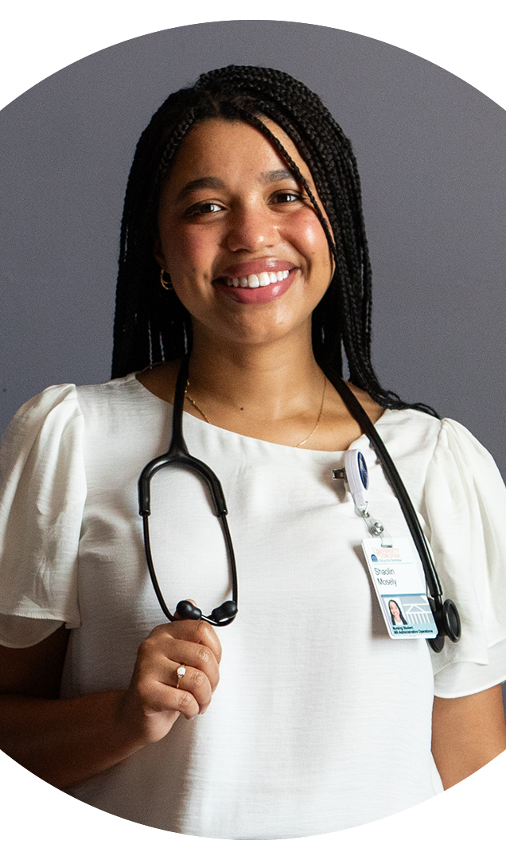
Clinical Schedules
The student develops the clinical schedule based on the preceptor’s established work schedule.
Faculty must have advance notice of the student’s schedule. The student is responsible for sharing the schedule with faculty.
Students generally begin shifts when the preceptor begins the shift and stay for 8 or 12 hours as negotiated.
Notes:
When adding pictures, be sure to add alt-tags to all presentation images.
Please note: Agenda items have been broken out into individual items in accordance with ADA digital accessibility best practices.

Slide 15
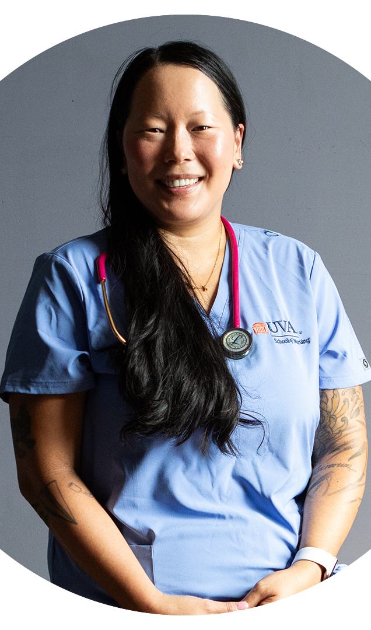
Professional standards for Students:
Preparedness
Attendance & Punctuality
Professional Demeanor & Engagement
Legal & Personal Limits

Slide 16
Preparedness
The student is consistently prepared to engage in clinical nursing activities.
Preparation includes physical, emotional, cognitive, and material readiness to enter the clinical setting in order to apply principles and skills already learned, as well as expand knowledge and skill acquisition.
Preparedness includes being well rested, nourished, oriented to the setting, and with all necessary student sign-in codes available for use.
The student is professionally attired for all experiences on the unit as delineated by the School of Nursing student uniform policy and the institutional/unit requirements.
The hospital and/or student ID and lab coat is required whenever entering the clinical environment.

Slide 17
Attendance & Punctuality
The student arrives in advance of the scheduled time for all clinical conferences and clinical learning experiences.
The student is present for each clinical experience arranged.
Absences: In the event of serious illness, the student must inform the clinical faculty, preceptor, and unit according to the specific clinical faculty, preceptor, and unit guidelines prior to the start of the clinical day.

Slide 18
Professional Demeanor & Engagement
The student maintains a professional demeanor during all clinical preparation and care experiences.
The student exhibits professional interpersonal communication skills with patients, families, health care team members, faculty, and peers at all times.
The student does not bring personal issues into the clinical experiences.
The student maintains professional boundaries at all times.
The student demonstrates compassion towards self and others.
The student is responsible for timely submission of clinical assignments and respective electronic documentation.

Slide 19
Legal & Personal Limits
The student:
Recognizes and functions within legal and personal limits as a student.
Seeks help appropriately to deliver care.
Maximizes clinical time and resources to advance clinical knowledge and skills.
Recognizes learning needs and actively seeks to fulfill identified learning needs outside of clinical (consultation with the preceptor, clinical faculty, or time in the simulated learning lab).
Maintains accountability for all actions.
Uses clinical time to focus on and enhance learning.
Recognizes when clinical learning opportunities are decreased (fatigue, quiet unit, etc) and reschedules time with the preceptor appropriately.
Maintains confidentiality.

Slide 20
Administering Medications
All students are expected to be prepared to administer all medications to all assigned patients during each clinical day.
For prelicensure students (BSN & master’s entry CNL only): Under no circumstances is any drug to ever be administered without first being checked by the preceptor for all of the “rights.”
The preceptor provides oversight of medication administration based as appropriate to the student’s level of competency as assessed by the preceptor.

Slide 21
The Student-Preceptor Working Relationship
Orienting Phase:
Introductions
Sharing learning & teaching styles
Establish trust
Clarify roles & expectations
Review & determine the schedule
Working Phase:
Teach, mentor, & coach the student during clinical activities
Simulate reasoning skills – think out loud
Challenge the student to think deeply and ask questions
Encourage reflection
Closing Phase:
Participate in the evaluation process
Facilitate closure with mutual positive regard
Consider the possibility of your ongoing role as a professional mentor

Slide 22
Resources
Visit this site: Preceptors • UVA School of Nursing
“It Takes a Village….”
Don’t hesitate to reach out to any of the following people:
Clinical Faculty
Course Professor
Clinical Coordinators & Specialty Leads
Director of Degree Program Administration
Faculty Directory • University of Virginia School of Nursing

Slide 23
Thank you for viewing this preceptor orientation module!

